Slide 1
Production Run Reports
By sdmay23-06

Slide 2
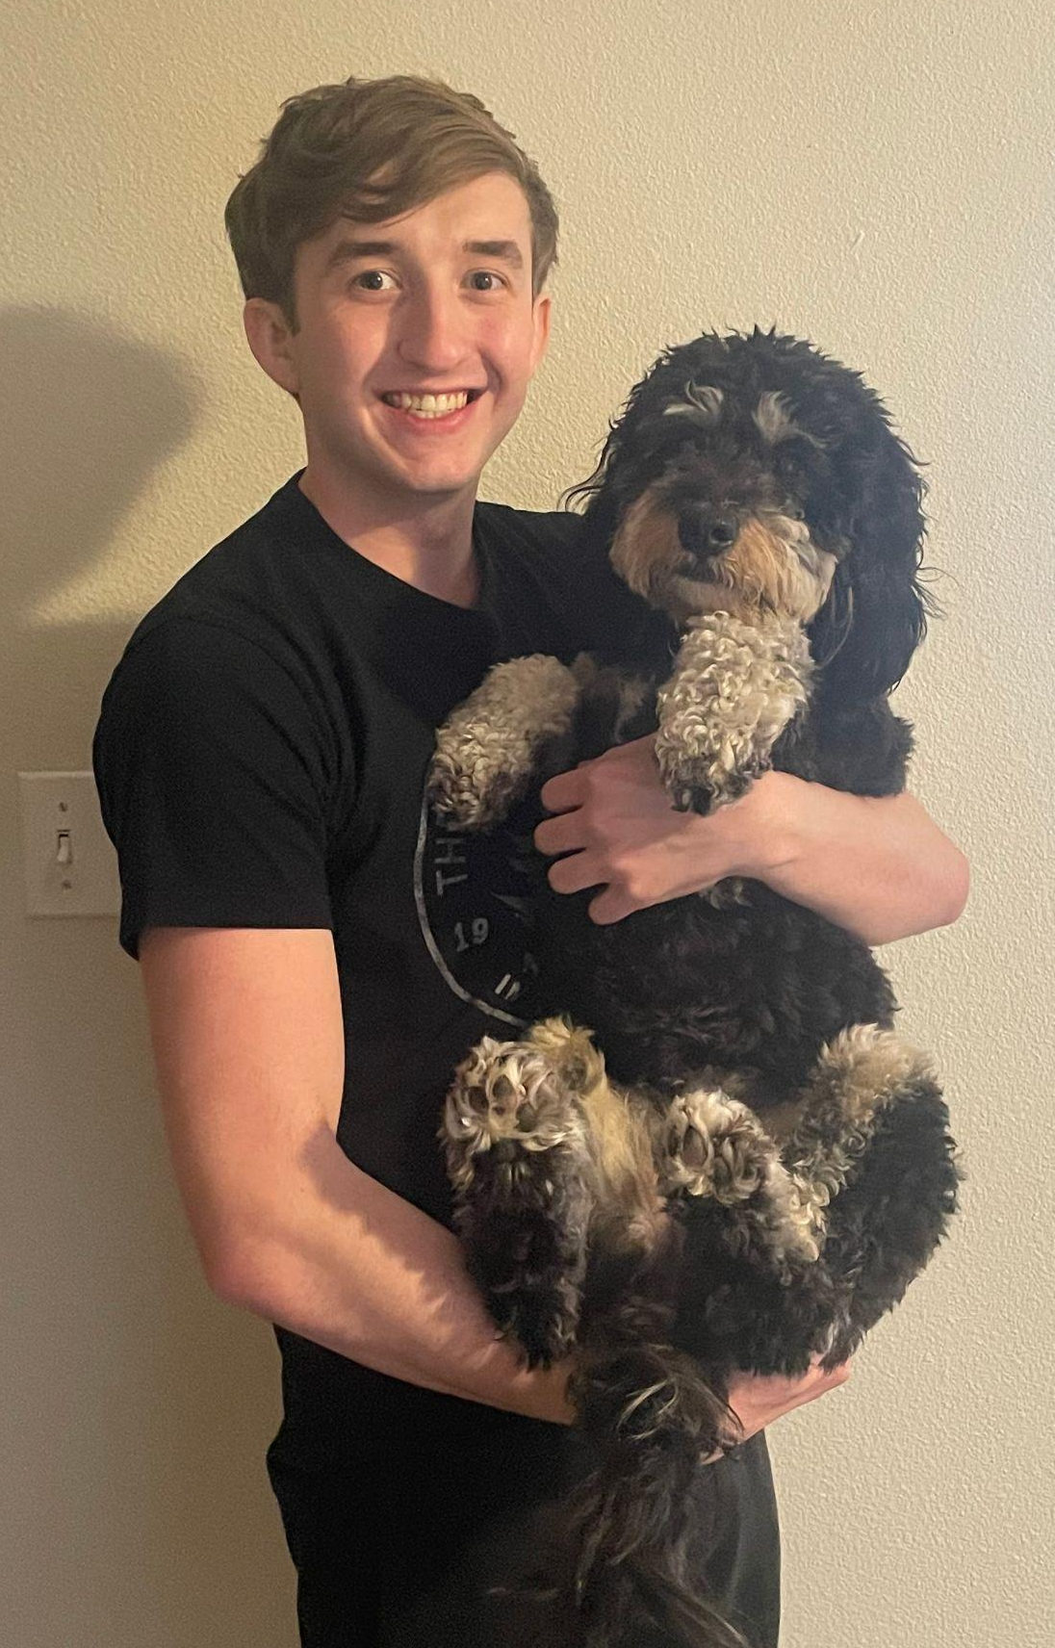
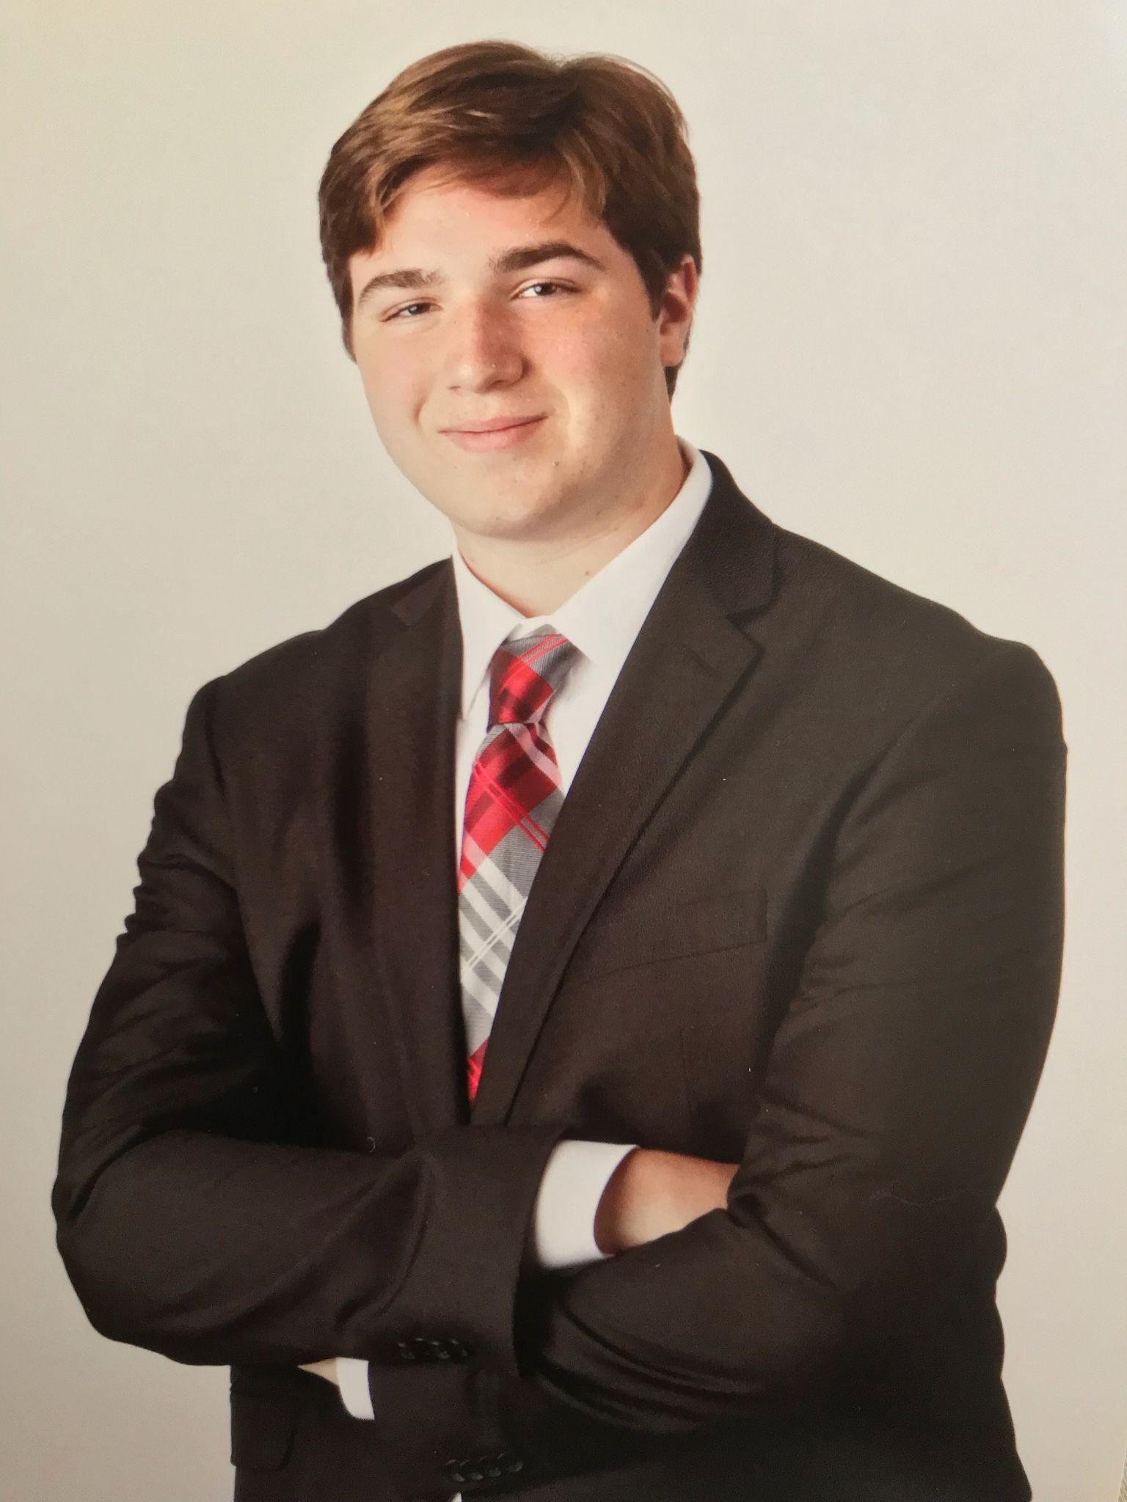
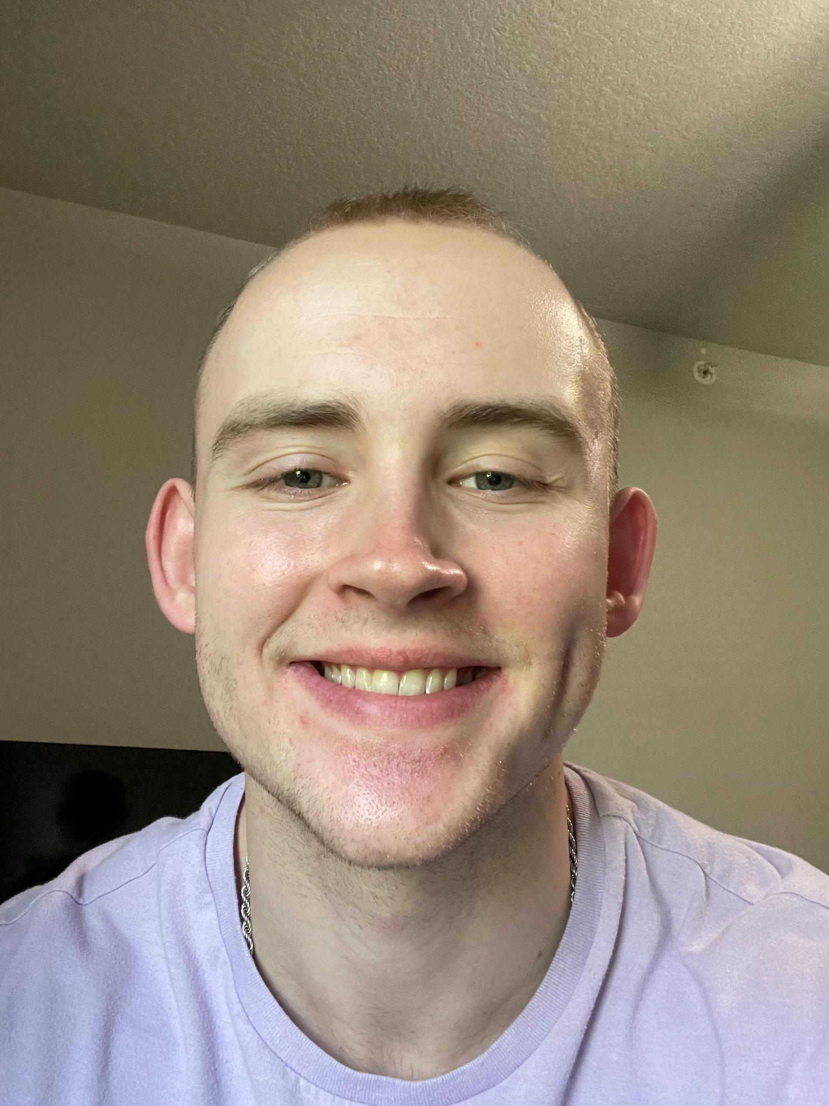
Team Members
Colton Carlson
Software Engineering
Hayden Havelka
Software Engineering
Connor Linn
Software Engineering
Jay Arnold
Computer Engineering
Noah Meyer
Software Engineering
Notes:
All

Slide 3
JEDA Polymers
1
Meet the client!
Notes:
Noah

Slide 4
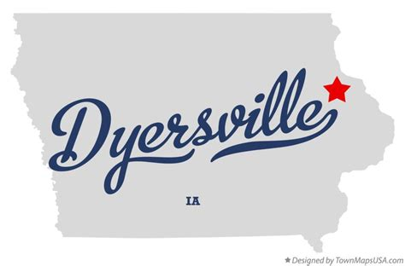
JEDA Polymers
Established in 2007.
Located in Dyersville, IA.
Refines raw materials into specified plastic usable by clients.
Notes:
Noah

Slide 5
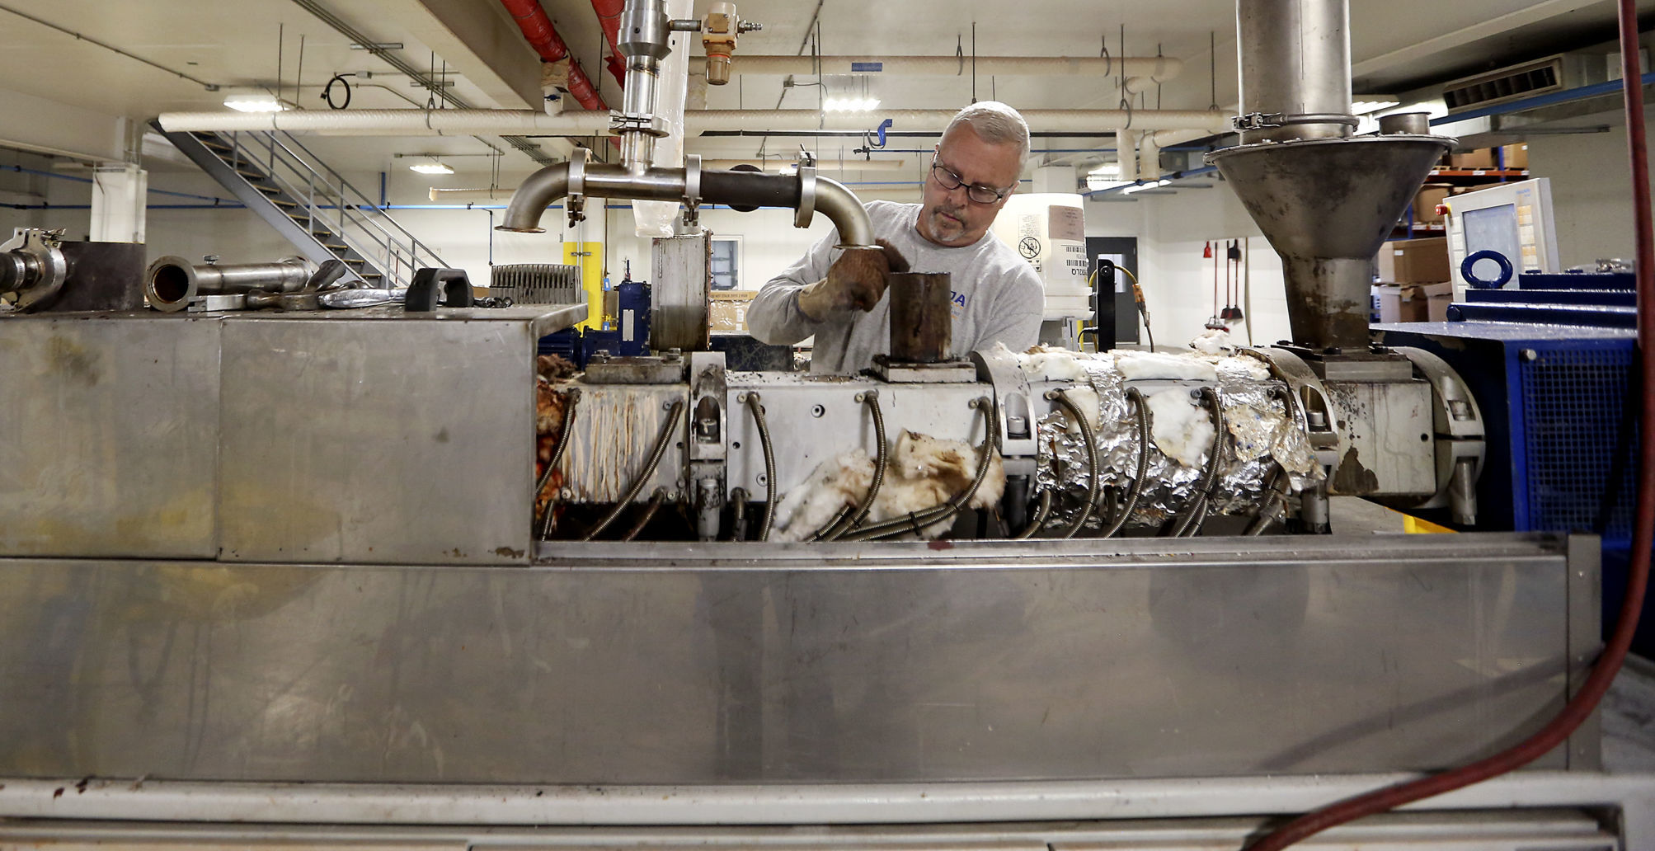
Facility Machines
Notes:
Noah

Slide 6
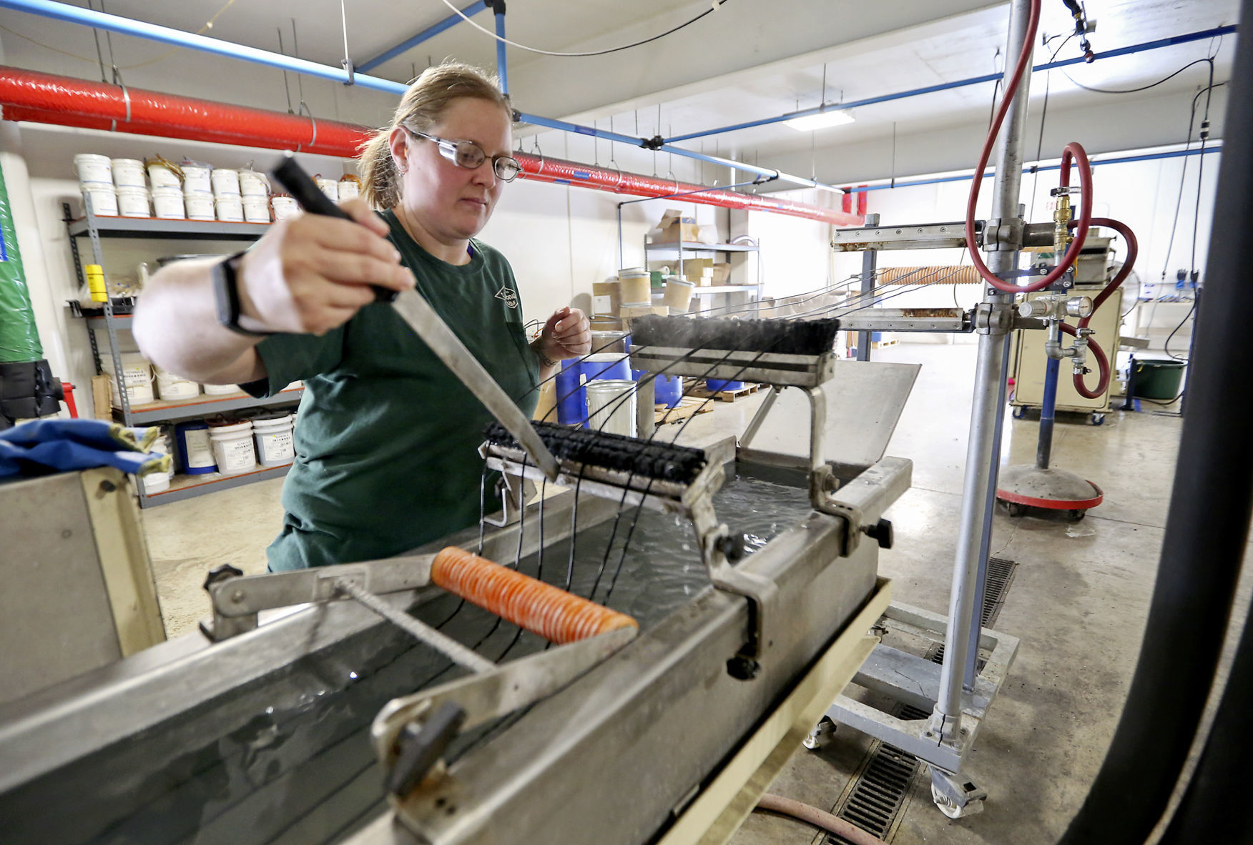
Facility Machines
Notes:
Noah

Slide 7
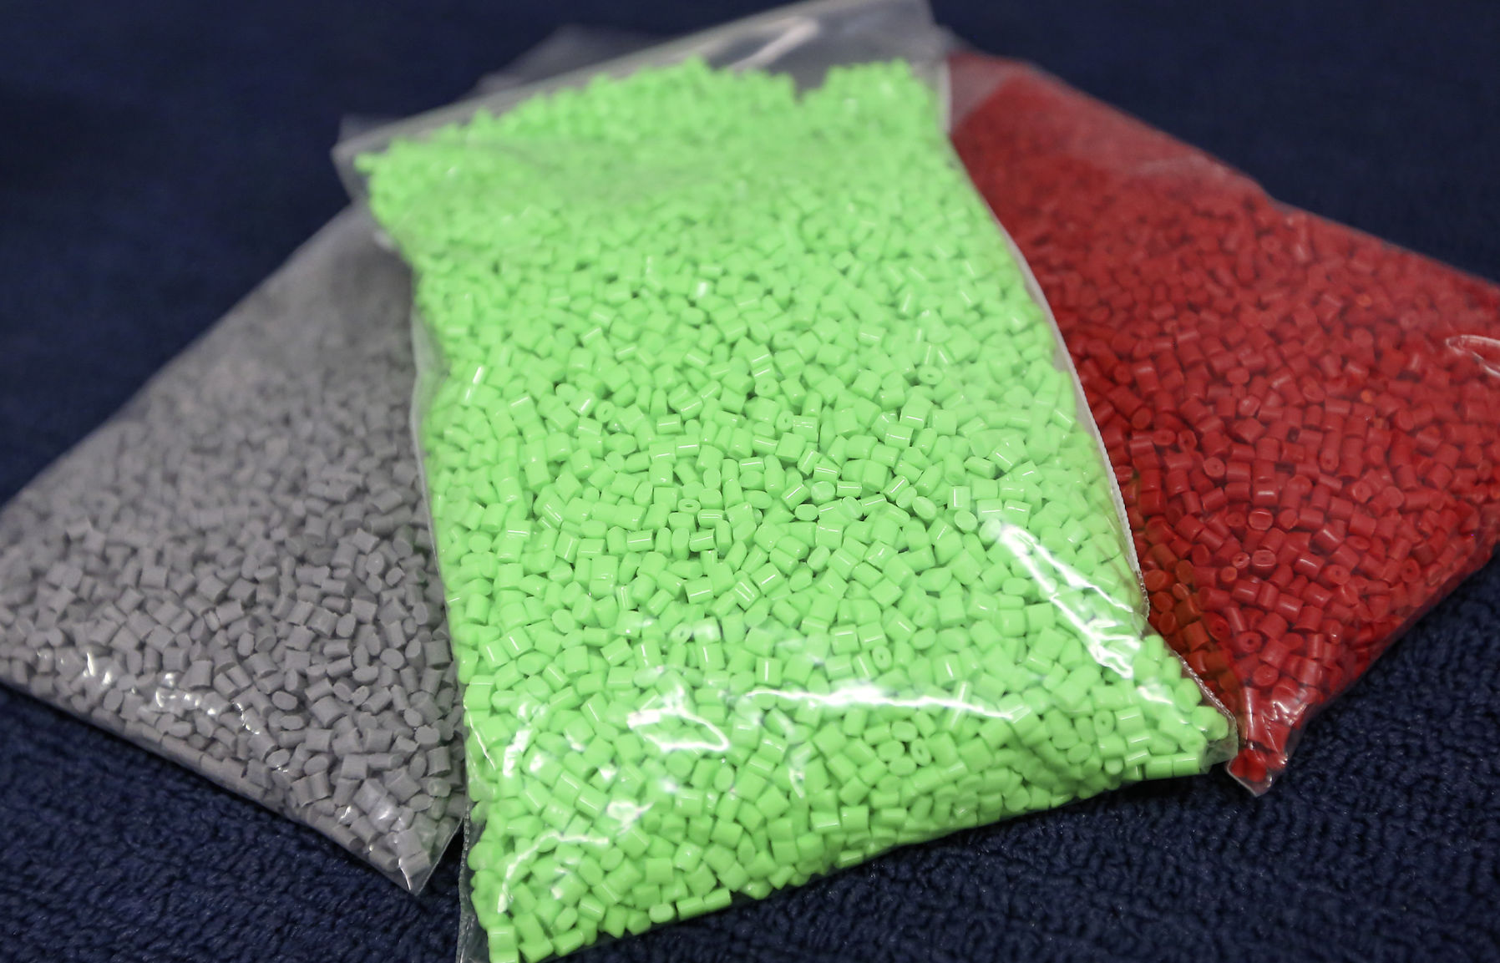
Final Product
Notes:
Noah

Slide 8
Project Introduction
2
Project Abstract
Notes:
Colton

Slide 9
Current Problem
Clients of JEDA Polymers want a fast and reliable way to verify the integrity of the product they received.
John Deeken, manually looks over data reported by factory lines, then reports the result to the customer.
Customers will call wanting immediate verification.
For a truly accurate result can take hours.
Prone to human error.
Notes:
Colton

Slide 10
Proposed Solution
An auto generating PDF report that condenses the thousands of data points into one easy to read file.
Verification within seconds instead of hours.
No human error.
No software engineers on staff to design their own system.
Notes:
Colton

Slide 11
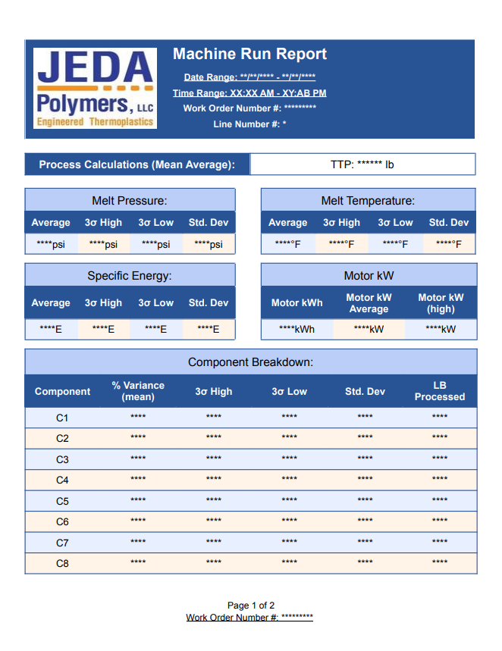
Report Template
Notes:
Colton

Slide 12
Requirements
3
Notes:
Colton

Slide 13
Functional Requirements
When a report request is made, a new accurate report is generated.
Users must be logged in to make a request.
Everyday at 11:59 PM CST, every report that finished that day will be emailed to the specified address.
Notes:
Colton

Slide 14
Non-Functional Requirements
Produce a report in 15 seconds.
Report generation will follow the agreed on template.
The system will support new manufacturing lines.
The frontend will be accessible from Mac and Windows.
Safari, Chrome, Firefox, Edge, and Opera.
Reports will be sent using internal email server.
Notes:
Colton

Slide 15
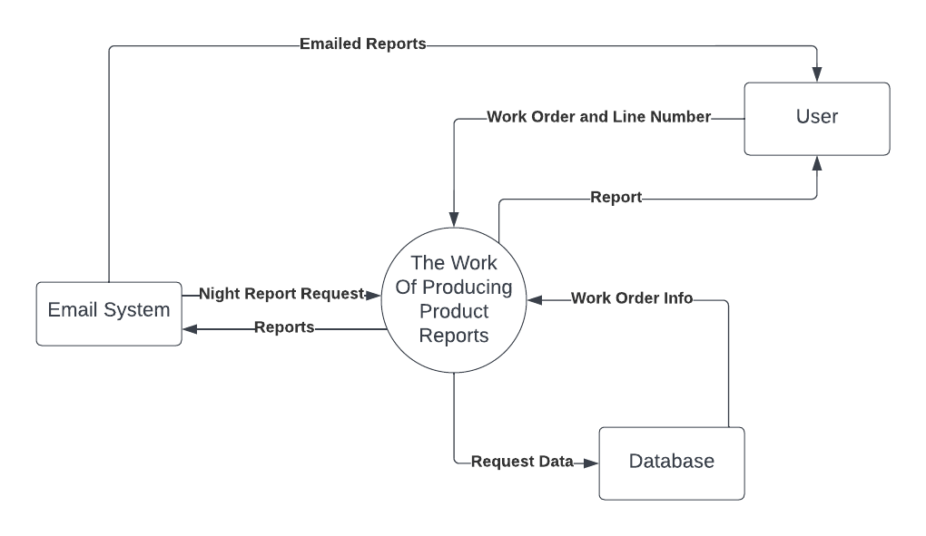
Context Diagram
Nightly Reports
Notes:
Colton

Slide 16
Proposed Solution
4
Design Mockups and Backend Structure
Notes:
Noah

Slide 17
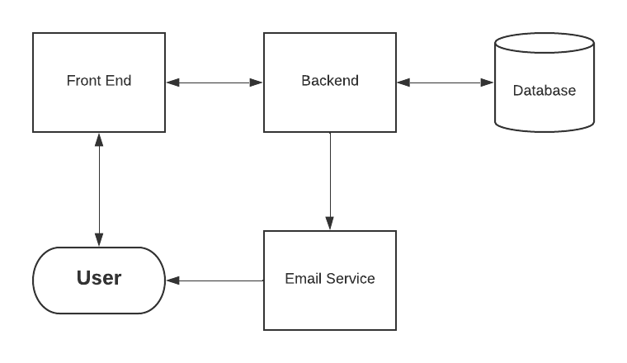
Basic Proposed Design Diagram
Notes:
Noah

Slide 18
Intended User Timeline
Notes:
Noah

Slide 19
Notes:
Hayden

Slide 20
Notes:
Hayden

Slide 21
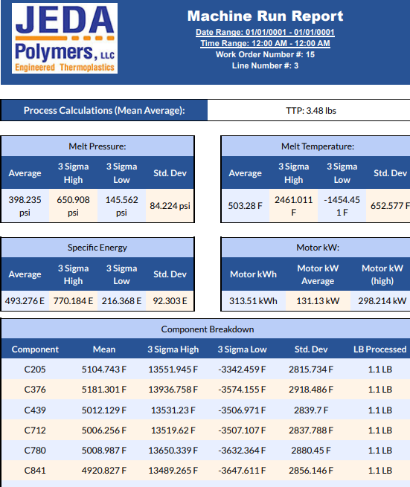
PDF Results

Slide 22
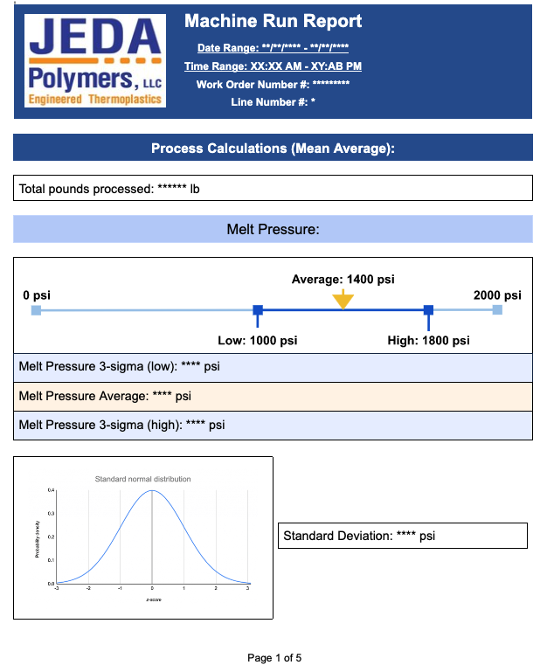
PDF Template
Notes:
Hayden

Slide 23
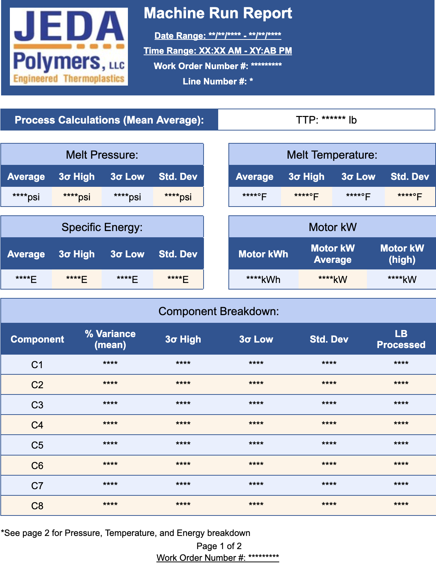
PDF Template
Notes:
Hayden

Slide 24
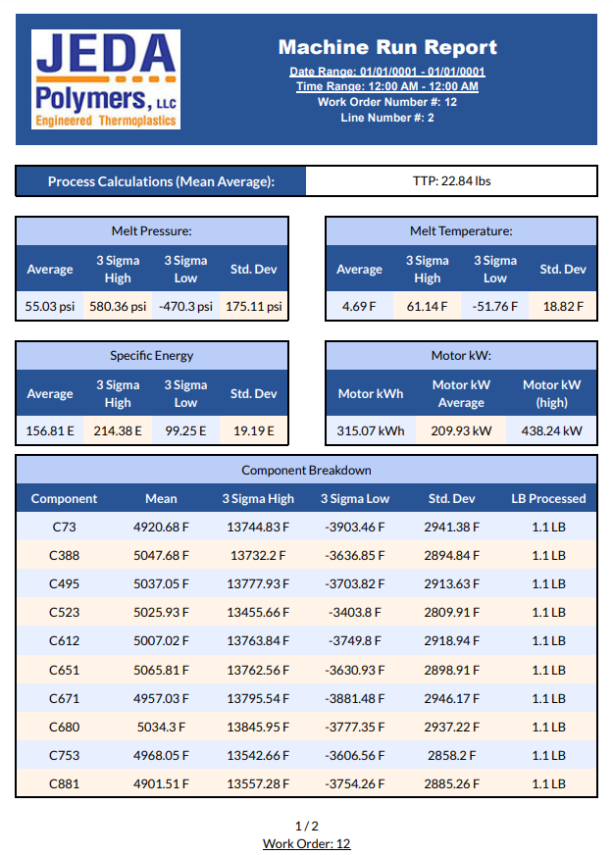
Current Prototype
Created with Random Data
Notes:
Colton

Slide 25
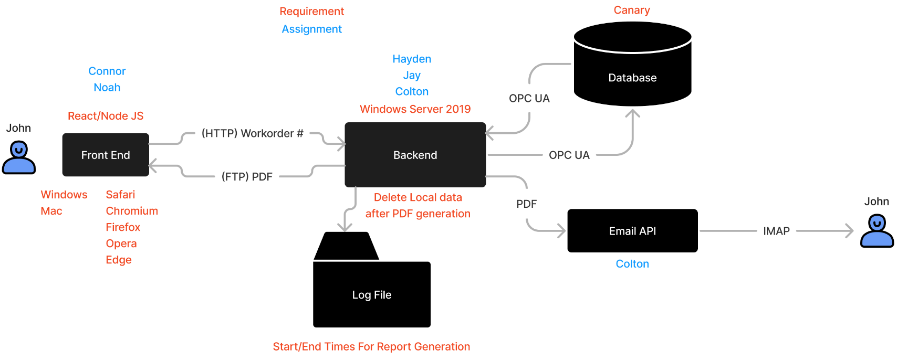
Architecture
Notes:
Colton

Slide 26
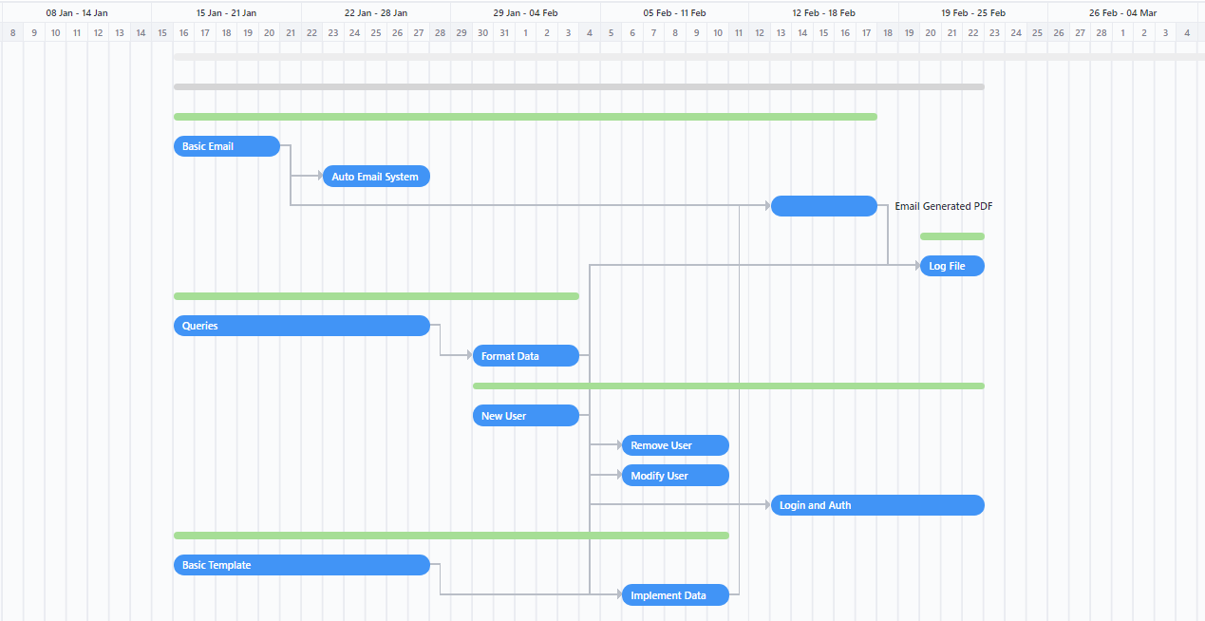
Backend
Notes:
Noah

Slide 27
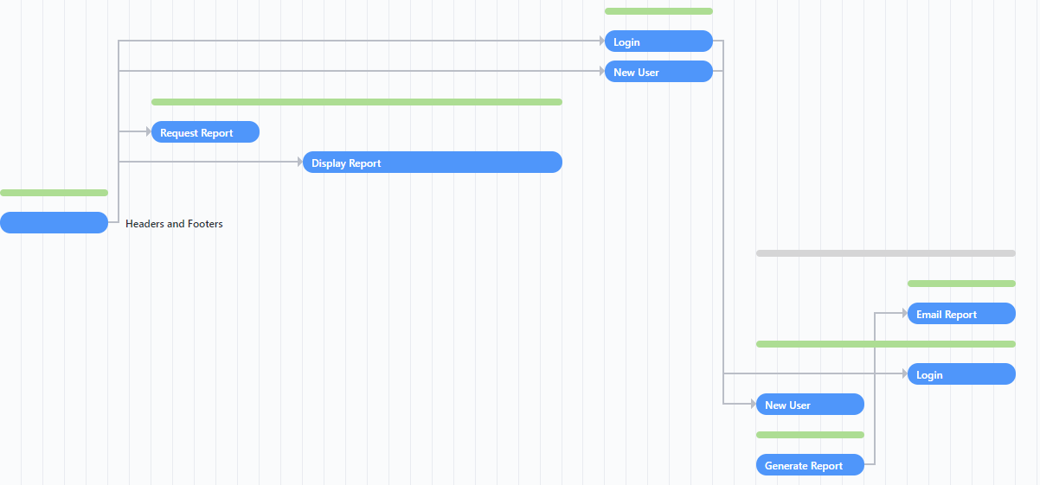
Frontend
Notes:
Noah

Slide 28
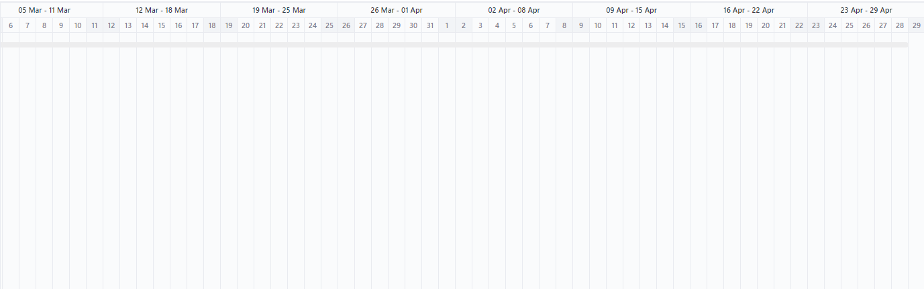
Testing & Beta
Notes:
Noah

Slide 29
Design Decisions
5
Why we chose these technologies
Notes:
Connor / Colton

Slide 30
Frontend
React JS vs Other Options
Considered PHP, JS, Flask, & Angular.
Clear Choice on almost every front.
Notes:
Connor

Slide 31
Decision Matrix
Criteria | PHP | React | JavaScript | Flask | Angular
Functionality | 3 | 5 | 4 | 1 | 3
Browser Compatibility | 5 | 5 | 3 | 2 | 1
Code Simplicity | 2 | 4 | 2 | 5 | 2
Speed | 3 | 5 | 5 | 2 | 3
Learnability | 1 | 3 | 2 | 5 | 1
Total (unweighted): | 14 | 22 | 16 | 15 | 10
*Higher value is better
*5 point scale
Notes:
Connor

Slide 32
Backend - Hosting
AWS / AZURE / Google Cloud
Cost
Complexity
Ubuntu LTS 22.04
Unknown customer familiarity
Windows 2019 Server
Currently used by client
Little setup from fresh install
Notes:
Colton

Slide 33
Backend - Database
Really didn't make a decision, it was given to us:
Canary Database
NoSQL
Non-Relational
Great for huge volumes of data
Notes:
Jay

Slide 34
Challenges
6
Issues we’ve encountered so far
Notes:
Colton & Jay

Slide 35
Challenges - PDF && Generation
Finalizing a PDF Design
PDFSharp
Last Updated 2015
IronPDF
Paid Licensing
QuestPDF
Open Source
Notes:
Colton

Slide 36
Challenges - General
Canary Database
Becoming familiar with canary
Doesn’t use SQL Queries
Remoting In & VPN
Mac devices could not remote into
General Domain Knowledge
Notes:
Jay

Slide 37
Ethics
7
Ethical Decisions
Notes:
Jay

Slide 38
We strive for the highest professional standards
The project will require little to no maintenance in the future.
The project will protect JEDA’s data and privacy.
The project will only fulfill JEDA’s needs and nothing else.
Our team has been acting in JEDA’s best interest, and we will continue to do so.
The project will not require more funding than given.
Notes:
Jay

Slide 39
Testing
8
Our plan to ensure a secure product
Notes:
Colton / Connor

Slide 40
Unit Testing
Frontend: Jest
Backend: ASP.net Utility
Notes:
Colton

Slide 41
Interface Testing
User Testing
Show to non-programmers to see how well the average person can navigate the site.
Also show the website to some frontend developers for an experienced outlook on the design.
Notes:
Connor

Slide 42
Robot Framework (Integration Testing)
Easily displayed results.
Can communicate test results between frontend and backend.
Easy to interpret where errors and failed tests are.
Notes:
Colton

Slide 43
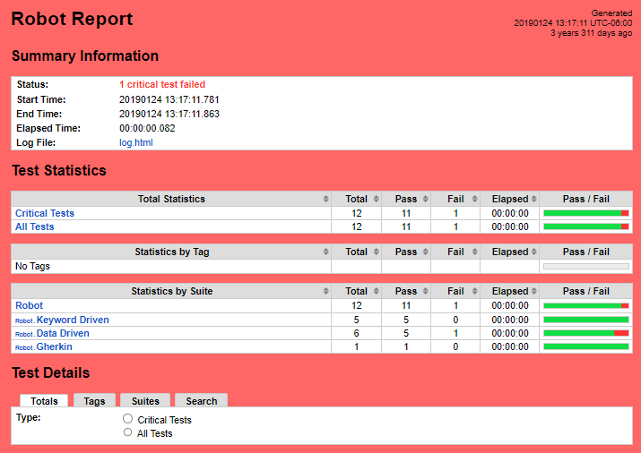
Robot Framework
Notes:
Colton

Slide 44
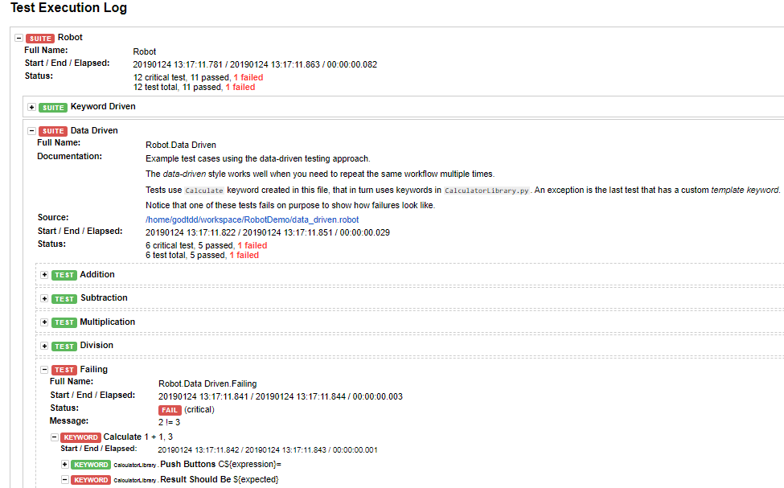
Robot Framework
Notes:
Colton

Slide 45
Regression Testing
Not Applicable
JEDA Polymers doesn’t have any current report generation for us to add on/modify
Notes:
Colton

Slide 46
System and Acceptance Testing
End to End Testing
Does a specified input from the front end produce the correct result in the backend?
Is that result displayed correctly on the front end?
Meet all requirements
Testable
“Beta” version given to client.
Will let client provide feedback after being able to use working product.
Notes:
Connor

Slide 47
Risk Analysis
9
What could go wrong?
Notes:
Noah

Slide 48
Risk Analysis Chart
Impact
 | Very Low | Low | Medium | High | Very High
Highly Probable | 5 - Moderate | 10 - Major | 15 - Major | 20 - Severe | 25 - Severe
Probable | 4 - Moderate | 8 - Moderate | 12 - Major | 16 - Major | 20 - Severe
Possible | 3 - Minor | 6 - Moderate | 9 - Moderate | 12 - Major | 15 - Major
Unlikely | 2 - Minor | 3 - Moderate | 6 - Moderate | 8 - Moderate | 10 - Major
Rare | 1 - Minor | 2 - Minor | 3 - Minor | 4 - Moderate | 5 - Moderate
Probability
Notes:
Noah

Slide 49
Notable Risks
Key
Severe
Major
Moderate
Minor
User information not in system - 12
User information fails to authenticate - 12
PDF displays incorrect data - 10
Malicious data injected into system - 10
PDF not emailed to the correct recipient - 6
Web Application fails to load on different browsers - 3
Notes:
Noah

Slide 50
Questions?
10
Notes:
All

